Slide 1
What’s Developmental Disabilities Got To Do With It? PRIMARY CARE CHALLENGES & DEVELOPMENTAL DISABILITIES
Dr. Sheryl White-Scott, FACP, FAAIDD
Medical Consultant, The Boggs Center on Developmental Disabilities - RWJMS
Medical Specialist, Metro DDSO, NYSOPWDD
Assistant Clinical Professor, New York Medical College
Building Capacity to Improve Adult Health Care for Patients with I/DD
is a project of The Boggs Center with funding from the NJ Council on Developmental Disabilities

Slide 2
Overview
Who ?
What?
How?
Notes:
Quick survey of who the participants are in the audience.
-medical students, interns/residents, attendings, nurses, pharmacists
Personal story to connect with the topic and the content
-Credentials
Connection with Monmouth Medical Center
Summary of the content for the presentation – case based presentation to illustrate medical needs of adults with I/DD.

Slide 3
Objectives
By the end of this session participants should be able to:
Identify definitions and demographics of Intellectual and other Developmental Disabilities (I/DD).
Describe clinical challenges to providing medical care for adults with I/DD in primary care settings.
Utilize available resources to develop solutions that support medical management of adults with I/DD.
Notes:
Survey the audience for involvement in care of individuals with DD
Identify the challenges in providing clinical care
Develop possible solutions and identify resources

Slide 4
Developmental Disabilities
Intellectual Disabilities
Cerebral Palsy
Autism
Epilepsy
Significant Learning Disabilities
Other Neurological Conditions
Notes:
People first language
Anecdote about DD
Resources for definitions – citation for law & AAIDD

Slide 5
Demographics
Prevalence Rates
1.49 % , about 4 million adults
1.5 million females
2.4 million males
National Health Interview Survey – Disability Supplement 1995
Notes:
Connect the numbers of individuals with I/DD with patient panels in practice
NCBDDD Tracking Activities – Autism and Developmental Disabilities Monitoring (ADDM) and Metropolitan Atlanta Developmental Disabilities Surveillance Program (MADDSP)

Slide 6
Clinical Presentation – A.S.
27 YO Male with Down Syndrome & Mild I/DD presents to emergency room with his Mom & Dad.
Present Medical History
Significant for new onset of abdominal discomfort and emesis x 1
Past Medical History
Hypothyroidism on Synthroid
Physical Exam
Vital Signs BP – 90/60 P – 110 T – 98.1 O2 Sat – 98 %
Abdomen – Positive Bowel Sounds in all four quadrants, soft, nontender, no distension
Notes:
Patient Presentation – Young male with I/DD living at home with family. Involves both ER and inpatient services.

Slide 7
Clinical Presentation – A.S.
Clinical Management
Initial ER assessment resulted in diagnosis of viral gastroenteritis.
Discharged home with instructions to drink fluids and return if no improvement.
Return to ER the next day due to persistent emesis, labs done and glucose is 995.
Admitted to medical unit, challenges to obtain labs and adhere to dietary restrictions.
Notes:
Clinical Challenges & Solutions:
Clinical presentations may be atypical and variable.
Comprehensive history & physical are indicated
Communication methods and natural supports assist health professionals

Slide 8
Across The Lifespan
Shortage of Health Professionals
Access to Quality Care
Transitions
Notes:
Clinical Connection with needs for primary care & DD
Educational services to promote education and awareness of physicians.
Medical care does not translate into quality care
Transitions from different stages – children to adult and adult to seniors to be highlighted

Slide 9
The Current State of Health Care for People With Disabilities
Elements of Effective Health Care
Professional education and training
Coordinated care with a team approach
Tools to ensure effective communication with patients
Allowing more time for medical visits
Accessible diagnostic and other equipment
Notes:
Clinical interventions can make a difference. Review the listed options.

Slide 10
Clinical Presentation Outcome – A.S.
Clinical Outcome
Diagnosed with Type I Diabetes
Discharged home on insulin and oral hypoglycemic medications
Continues to have challenges with insulin regimen, fingersticks & dietary restrictions
Clinical Challenges & Resolutions
Clinical presentations may be atypical and variable
Comprehensive history and physical are indicated
Communication methods and natural supports are the key
Notes:
Using technology – Dexcom for continuous glucose monitoring
Education for patient and family
Ongoing relationship with primary care physician

Slide 11
Barriers to Health Care
Lack of information
Shortage of appropriately trained health providers
Access and transportation problems
Lack of appropriate equipment
Lack of health insurance coverage
Cultural and language barriers
Limited patient education materials
HEALTHY PEOPLE 2010, SURGEON GENERAL’S REPORT ON HEALTH DISPARITIES AND MENTAL RETARDATION 2002
Notes:
Healthy People 2010: Chapter 6 www.healthy people.gov
Health Disparities Conference www.surgeongeneral.gov/topics/mental retardation
Barriers for physically impaired: May require assistance to gain positioning for exam, May have communication difficulties
Appearance may give misperception of abilities
Providers: No specific training, negative attitudes, lack of support staff, lack of time, condescending attitude due to lack of information about disability, communication problems
Being able to make an informed choice
Barriers compounded by poverty and racial/ethnic disparities

Slide 12
Focus Group - Rutgers Robert Wood Johnson Medical School
Barriers to Care
Limited knowledge and ability to communicate
Lack of knowledge of community resources
Lack of psychiatric and behavioral consultation & treatment
FOCUS GROUP – DIVISION OF GENERAL INTERNAL MEDICINE, DEPT OF MEDICINE (11/15/18)
Notes:
Need for a tertiary resource to provide expert consultation and back up
Grand Rounds format
Expand psychiatric and behavioral resources
Establish an expert medical resource to provide consultation
Enhance care coordination to link patients with community services and supports

Slide 13
Clinical Presentation – Q.G.
42 YO Male with Autism, Hypertension & Moderate I/DD presents to clinic with group home staff
Present Medical History
significant for swelling of the right jaw with no visible pain or discomfort with some difficulty eating.
Past Medical History
Hypertension controlled with HCTZ and Amlodipine
Physical Exam –
Vital Signs BP - 160/100 P 92 T – 97.2 O2 Sat – 97 %,
HEENT significant for swelling of right mandible, no point tenderness appreciated, unable to examine oral cavity, keeps teeth clenched.
Notes:
Clinical Presentation – Adult male with Autism & I/DD. Review challenges in data collection. Diagnostic consideration with challenging behaviors in dealing with adults with Autism.
Brief overview of medical issues as comorbidities with Autism.

Slide 14
Clinical Presentation – Q.G.
Clinical Management
Sent to ER for evaluation and diagnosed with Cellulitis started on Amoxicillin.
Dental evaluation one day following ER evaluation and BP – 82/54 P – 60
Sent back to ER for evaluation and treatment.
Hypotension corrected with fluids.
Nurse reports swallowing meds not chewing due to pain
Notes:
Pain management
Hypotension secondary to medications now swallowing instead of chewing?
Support personnel are very essential
Look for clinical cues

Slide 15
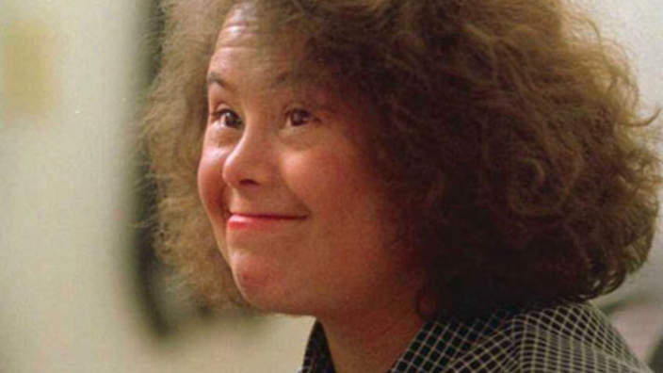
Core Competencies on Disability for Health Care Education (April 2018)
Notes:
Education and training one of the barriers of care. Resources including Core Competencies build foundation for education and trauma.
Check to see how these measures can be implemented in your training programs and discuss any barriers or solutions.

Slide 16
Education of Health Professionals
Core Competencies on Disability for Health Care Education (Alliance)
http://go.osu.edu/disabilitycompetencies
Resource Modules on Health of People with Intellectual Disabilities (LEND)
http://www.iddhealthtraining.org
Healthcare for Adults with I/DD: Toolkit for Primary Care Providers
https://vkc.mc.Vanderbilt.edu/etoolkit
AADMD Virtual Grand Rounds (American Academy of Developmental Medicine and Dentistry)
https://aadmd.org
H-CARDD – Health Care Access Research and Developmental Disabilities (Canadian)
www.hcardd.ca
Notes:
Review and give brief overview for these web based resources.

Slide 17
Clinical Presentation – Q.G.
Diagnoses:
Fracture of Right Mandible
Abscess
Clinical Management:
Dental Clinic refers to Medical Clinic
Consultation for medical clearance for dental surgery under general anesthesia
Notes:
Pain management
Polypharmacy
Medical Management

Slide 18
Clinical Presentation – Q.G.
Outcome:
Surgery completed, fracture healed, abscess resolved
Clinical Challenges & Resolutions
Pain management in acute settings
Medical management of comorbidities
Completion of routine medical tests and procedures with challenging behaviors
Notes:
Clinical Challenges & Resolutions:
1. Pain management in acute settings, Pain is the fifth vital sign, Measures of pain in adults with I/DD
2. Medical management of comorbidities
3. Completion of routine medical tests and procedures with challenging behaviors (Autism)

Slide 19
Statistics
Current estimates are that there are 641,000 adults age 60 and older with intellectual and other developmental disabilities.
This will double to 1,242,794 by 2030 when all of the post World War II “baby boom” generation, born between 1946 – 1964, will be in their sixties.
Notes:
Updated statistics looking at the aging of individuals with I/DD

Slide 20
Secondary Disabilities
“Secondary disabilities are those conditions that are related to an individual’s primary disability and can result in further deterioration in health status, functional capacity, and quality of life”
~ INSTITUTE OF MEDICINE, 1991
Notes:
Connect with clinical presentation case

Slide 21
Secondary Conditions
Many are preventable or the impact can be minimized
Appropriate interventions/treatment can be used
If untreated, may cause decline in abilities or health
Can have a great impact on quality of life

Slide 22
Clinical Presentation – I.F.
70 YO female with Epilepsy and Profound I/DD presents to urgent care with group home staff and elderly aunt.
Present Medical History
significant for a cough and swelling of her right knee.
Past Medical History
significant for epilepsy controlled for many years on phenobarbital and valproic acid.
No recent seizures reported.
Nonambulatory and mobility via wheelchair.
Physical Exam –
Vital Signs BP – 100/70 P – 64 R- 16 T – 99.2 O2 Sat – 94 %
Lung exam significant for a few coarse ronchi, no rales or wheezes.
Right lower extremity edema, no erythema, no increased warmth, grimaces with range of motion
Notes:
Clinical presentation for older adult with I/DD. Management challenges with aging and long term comorbidities/medications.

Slide 23
Clinical Presentation – I.F.
Clinical Management
Started on oral antibiotics for bronchitis and returned home from clinic
Two days later cough improved
Physical exam noted increased swelling of right lower leg
Returned to medical clinic for evaluation
Notes:
Clinical Challenges & Resolutions:
Complications with long term use of medications, Polypharmacy
Secondary comorbidities with I/DD
Aging and end of life issues

Slide 24
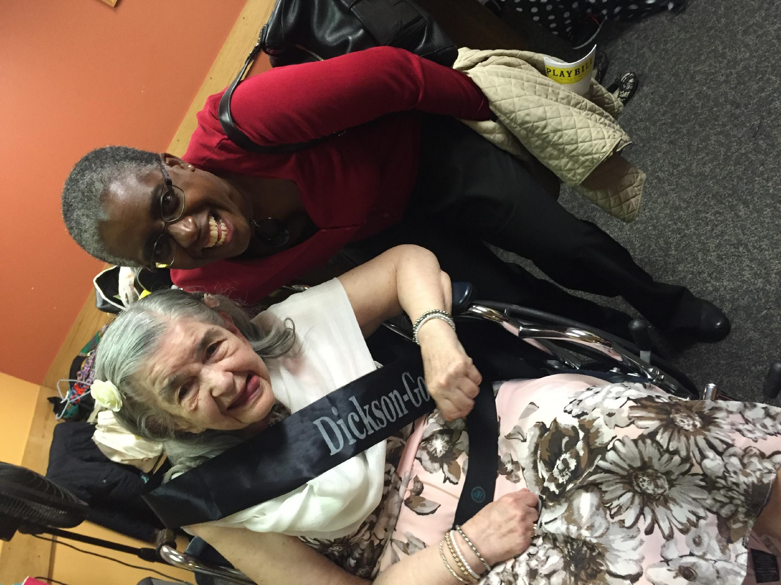
Life Expectancy & DD
Chronic Respiratory Infections
Heart Conditions
Infections
Reduced Mobility
Epilepsy & Refractory Seizures
Dependency in eating & toileting
Severe & Profound Intellectual Disabilities
Notes:
Current COVID – 19 Outbreak

Slide 25
Clinical Outcome – I.F.
Diagnoses:
Fracture of Right Femur and Osteoporosis
Clinical Challenges & Resolutions
Complications with long term use of medications
Secondary comorbidities with I/DD
Aging and end of life issues
Notes:
Etiology of fracture, ? Pathological versus abuse, Identify clinician's schedule and needs.

Slide 26
Osteoporosis Risk Factors: DD
Women:
Amenorrhea (absence/irregular periods)
Post menopausal
Nulliparous
Caucasian or Asian Ethnicity
Very thin or small stature
Down Syndrome, Turner Syndrome
Notes:
26
Nutritional – Enteral Feedings, Failure to Thrive
Gyn – Obtaining histories, menstrual chart, genetic syndromes

Slide 27
Osteoporosis Risk Factors: DD
Epilepsy
Long term use of medications
Anticonvulsants, Steroids, PSYCHOTROPICS
Nutritional & GI Comorbidities
Limited sun exposure
Decreased weight bearing activities
Prolonged immobility
Related Endocrine Disorders -Hypothyroidism
Notes:
27
Comorbid psychiatric conditions and use of psychotropic medications
Genetic syndromes that impact bone mineral turnover, for example Turner’s Syndrome

Slide 28
Osteoporosis: Screening/Treatment
Clinical Assessment
Assess for pain or changes in gait/mobility on every visit
Testing
DEXA Scan
Treatment
Alendronate/Denosumab/Zoledronic Acid
Notes:
28
Challenges with exam and testing. Is sedation indicated?
Denosumab (Prolia) Monoconal Antibody
Teriparatide (Forteo) Parathyroid hormone
Zoledronic Acid (Reclast, Zometa)
Alendronate (Fosamax) Biphophonate

Slide 29
Osteoporosis: Prevention
Adequate Nutrition (Calcium/Vitamin D)
Weight Control
Exposure to sunlight
Optimize Seizure control
Avoid caffeine, nicotine
Exercise/Fall prevention
Notes:
29
Challenges to implementing prevention efforts.

Slide 30
End Of Life Issues
Decision Making
Advance Directives
Bereavement Counseling
Planning & Interventions
Notes:
General overview, specifics will vary depending on location and individual needs.

Slide 31
Take Home Points
List two solutions to clinical challenges for health professionals providing care to individuals with developmental disabilities
_____________________________
_____________________________
Notes:
Reviewed definitions and demographics
Discussed barriers and challenges to health care management’
Illustrated solutions to health care challenges
I would challenge you to be aware and consider changes you can make in terms of your management with individuals with I/DD or is you teach residents or are in subspecialty how you can collaborate your improved health care

Slide 32
Take Home Points
Individuals with developmental disabilities are a diverse group
Awareness & knowledge of developmental disabilities will enhance health care delivery
Health & Wellness is the key across the lifespan
Notes:
This is the overview I hope there will be an opportunity to follow up with case conferences or future grand rounds on specific topics that would be of interest
The Boggs Center is an excellent resource for New Jersey and Rutgers Robert Wood Johnson System

Slide 33
References
Alliance for Disability in Health Care Education (2018). Core Competencies on Disability for Health Care Education. Peapack, NJ: Alliance for Disability in Health Care Education. Http://www.adhce.org
Anderson, Lynda Lahti, et al. “The State of the Science of Health and Wellness for Adults With Intellectual and Developmental Disabilities.” Intellectual and Developmental Disabilities, vol. 51, no. 5, Oct. 2013, pp. 385–398., doi:10.1352/1934-9556-51.5.385.
“Are Autism and Overeating Linked?” Https://Columbian.gwu.edu/, Columbian College of Arts & Sciences, 11 Oct. 2017, columbian.gwu.edu/are-autism-and-overeating-linked.
Daniel, Hilary, et al. “Addressing Social Determinants to Improve Patient Care and Promote Health Equity: An American College of Physicians Position Paper.” Annals of Internal Medicine, 17 Apr. 2018, pp. 577–578.
Hall, Allyson, et al. “Patterns in Primary Health Care Utilization Among Individuals With Intellectual and Developmental Disabilities in Florida.” Intellectual and Developmental Disabilities, vol. 45, no. 5, Oct. 2007, pp. 310–322., doi:10.1352/0047-6765(2007)45[310:piphcu]2.0.co;2.
Krahn, Gloria L., and Michael H. Fox. “Health Disparities of Adults with Intellectual Disabilities: What Do We Know? What Do We Do?” Journal of Applied Research in Intellectual Disabilities, vol. 27, no. 5, Sept. 2014, pp. 431–446., doi:10.1111/jar.12067.
Mcneil, Catriona M. “The Promise.” Annals of Internal Medicine, vol. 171, no. 3, 6 Aug. 2019, pp. 218–219., doi:10.7326/m18-2403.
Minihan, Paula M., et al. “Desired Educational Outcomes of Disability-Related Training for the Generalist Physician: Knowledge, Attitudes, and Skills.” Academic Medicine, vol. 86, no. 9, Sept. 2011, pp. 1171–1178., doi:10.1097/acm.0b013e3182264a25.
Peterson-Besse, Jana. “Impact.” Institute on Community Integration, 2016, ici.umn.edu/products/impact/291/291.pdf.
Rudowitz, Robin, et al. “10 Things to Know about Medicaid: Setting the Facts Straight.” The Henry J. Kaiser Family Foundation, Kaiser Family Foundation, 12 Mar. 2018, www.kff.org/medicaid/issue-brief/10-things-to-know-about-medicaid-setting-the-facts-straight/.
Sullivan, William F., et al. “Primary Care of Adults with Intellectual and Developmental Disabilities: 2018 Canadian Consensus Guidelines.” Le Médecin De Famille Canadien, vol. 64, Apr. 2018, pp. 254–279.
Swetlik, Carol, et al. “Adults with Autism Spectrum Disorder: Updated Considerations for Healthcare Providers.” Cleveland Clinic Journal of Medicine, vol. 86, no. 8, Aug. 2019, pp. 543–553., doi:10.3949/ccjm.86a.18100.
Trollor, Julian N., et al. “Intellectual Disability Health Content within Medical Curriculum: an Audit of What Our Future Doctors Are Taught.” BMC Medical Education, vol. 16, no. 1, 2016, pp. 1–9., doi:10.1186/s12909-016-0625-1.
Wilkinson, Joanne, et al. “‘Sometimes I Feel Overwhelmed’: Educational Needs of Family Physicians Caring for People with Intellectual Disability.” Intellectual and Developmental Disabilities, vol. 50, no. 3, June 2012, pp. 243–250., doi:10.1352/1934-9556-50.3.243.
Notes:
Reminder not to read. Available resources and references for adults with I/DD

Slide 34
Contact Information
Dr. Sheryl White-Scott
Developmental Disabilities
Medical Specialist
swhitescottmd@mac.com
Notes:
Bernard Carabello – misdiagnosed during his childhood as having mental retardation, he has cerebral palsy without cognitive disabilities and lived at Willowbrook from age 3 to 21 in 1972. Now we count him as a colleague, just retired, and a friend but now advocates for others. Remember to keep the individual first.
We know we will not be able to cover everything in this presentation so please know that we are available for your questions or concerns.

Slide 35
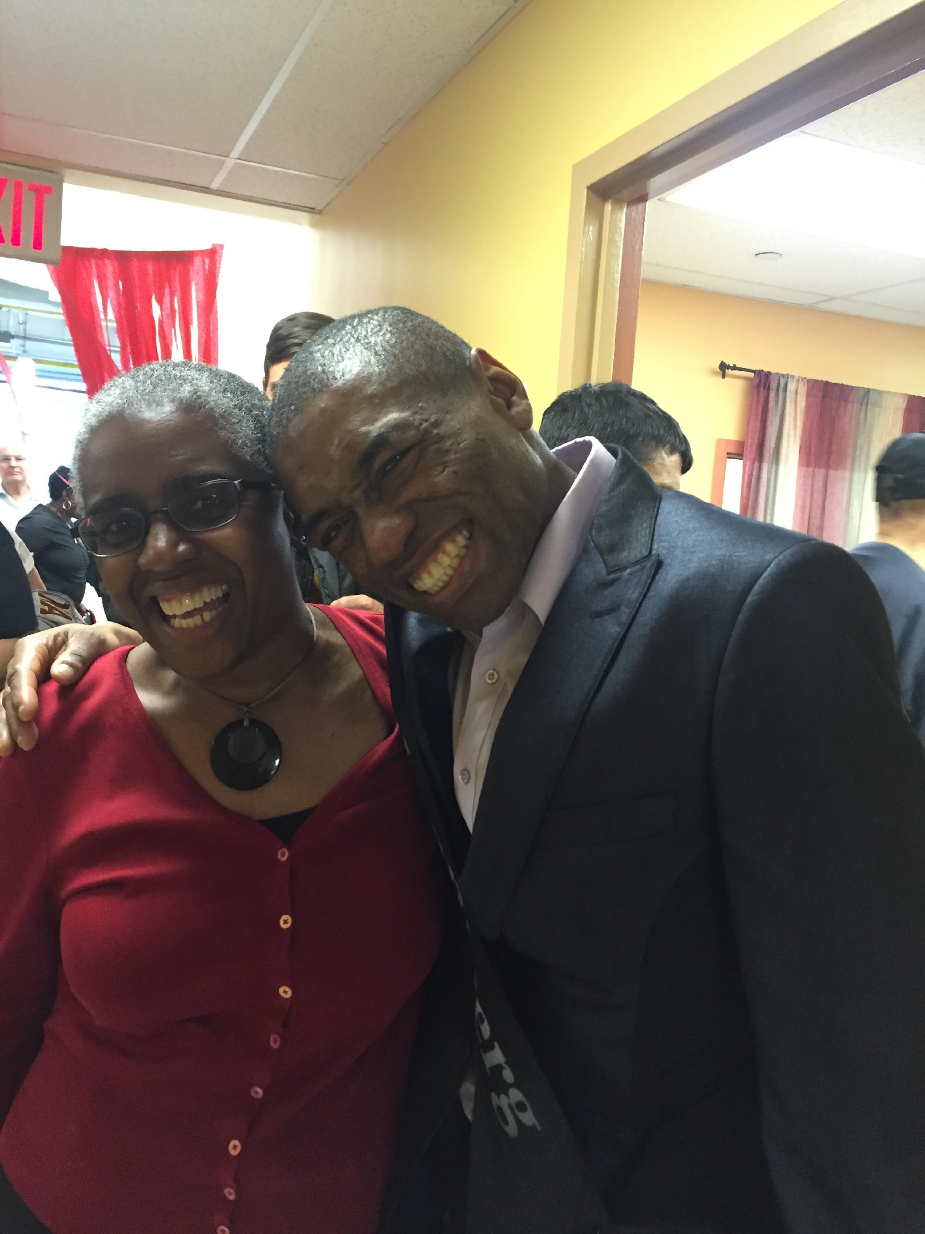
Questions ?

Slide 36
Funding Acknowledgment & Disclaimer
This work is supported with a grant funded by the New Jersey Council on Developmental Disabilities, in part by grant number 2001NJSCDD-02, from the U.S. Administration for Community Living, Department of Health and Human Services, Washington, D.C. 20201. Grantees undertaking projects with government sponsorship are encouraged to express freely their findings and conclusions. Points of view or opinions do not, therefore, necessarily represent official ACL policy.

